Slide 1
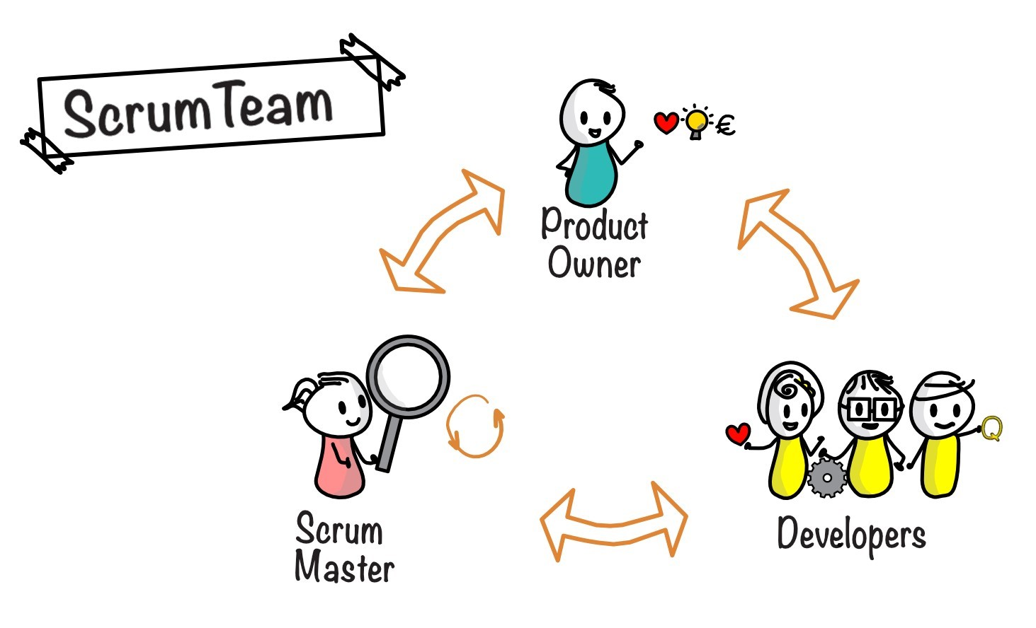
SCRUM-AGILE TEAM
Presentation by: James Soto
October 14, 2022
Notes:
Line spacing + Page numbers

Slide 2





Our Team
Product Owner
Scrum Master
Developer
Tester
Client

Slide 3
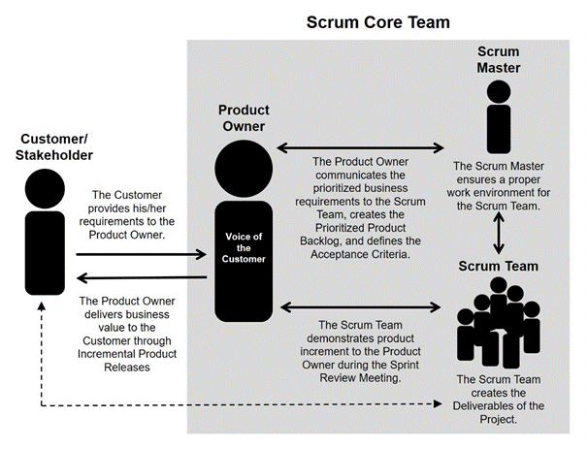
Roles
Product Owner
Communicates the prioritized business requirements to the scrum team
Defines the acceptance criteria
Defines and prioritizes the product backlog
Evaluate the completely work and provide feedback
Scrum Master
Ensures a proper work environment for the team
Keeps the entire team informed and on track
Coaches the team members
Hosts the daily stand-up meetings
Assists product owner with product backlog
Removes roadblocks
The Scrum Team - Developer
Achieve the goals define for each sprint
Attend daily scrum meetings to update other team members
Create the deliverables
Identify improvements during sprint reviews to help in the next sprints
Participate in retrospect project meetings

Slide 4
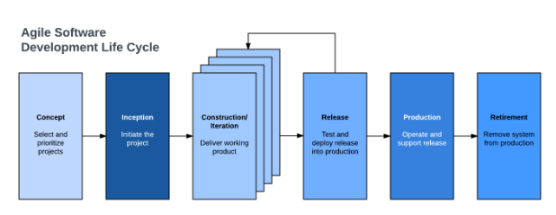
Agile SDLC

Slide 5
SDLC Phases
Concept
Inception
Construction
Iteration
Release
Maintenance
Production
Retirement
The stakeholder will determine the objective and scope of the software. The Product Owner documents the key requirements of the product.
The QA team checks to ensure the product is free of bugs or issues before releasing the software.
Product owner creates the development team. The team designs a mockup for the UI.
The development works on the requirements. The team completes tasks during sprints.
The development team provides regular support to the customer to ensure that the software runs smoothly without any bugs.
Retirement of a system when new software is being introduced or has become outdated.

Slide 6
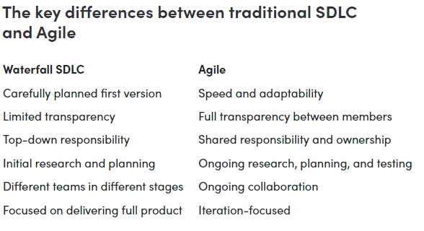
Waterfall Vs Agile

Slide 7
Waterfall Approach and Consideration Factors
The process would have been different if we used a waterfall development approach because the tasks/phases are done in linear steps where one tasks/phase needs to be considered done before moving onto the next tasks/phase as a deliverable. In waterfall the team establishes the requirements early in the project which could cause issues further into development if an issue comes up which then requires the team to go through every phase/tasks to find the error. Waterfall uses a fixed timeline where everything is mapped out before the project starts. During development, the client or stakeholders are not involved with the process, which stops the team from receiving feedback and implementing any changes.
The factors I would consider if I were to choose a waterfall approach would be the size of the project, does the project require flexibility or is it a fixed project with a set schedule and budget.

Slide 8
Citations
https://www.qrpinternational.be/blog/glossary/who-is-the-scrum-developer-role-and-responsabilities/
https://www.lucidchart.com/blog/agile-software-development-life-cycle
https://www.forbes.com/advisor/business/agile-vs-waterfall-methodology/
Citations for Pictures
https://www.orangescrum.com/tutorial/agile-scrum-management-an-overview/understanding-the-scrum-team-and-scrum-roles
https://www.scrum.org/resources/blog/equality-accountabilities-scrum

